Slide 1

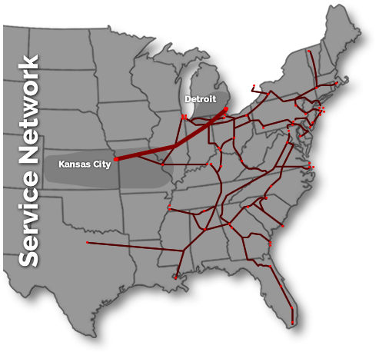
255 Detroit Kansas City
Cut Off Day | Cut Off Time | Departure Day | Departure Time | Arrival Day | Arrival Time | Available at Ramp | Available for Door Service by Appt | Available for Door Service by Appt | Available for Door Service by Appt
 |  |  |  |  |  |  | (local; 0-50 miles from terminal) | (51-199 miles from terminal) | (200+ miles from terminal)
Tuesday | 00.01 | Tuesday | 02:20 | Wednesday | 02:45 | 10:00 | 12:00 | 16:00 | Next morning 0600
Wednesday | 00.01 | Wednesday | 02:20 | Thursday | 02:45 | 10:00 | 12:00 | 16:00 | Next morning 0600
Thursday | 00.01 | Thursday | 02:20 | Friday | 02:45 | 10:00 | 12:00 | 16:00 | Next morning 0600
Friday | 00.01 | Friday | 02:20 | Saturday | 02:45 | 10:00 | 12:00 | 16:00 | Next morning 0600
Saturday | 00.01 | Saturday | 02:20 | Sunday | 02:45 | 10:00 | 12:00 | 16:00 | Next morning 0600
Sunday | 00.01 | Sunday | 02:20 | Monday | 02:45 | 10:00 | 12:00 | 16:00 | Next morning 0600
256 Kansas City Detroit
Cut Off Day | Cut Off Time | Departure Day | Departure Time | Arrival Day | Arrival Time | Available at Ramp | Available for Door Service by Appt | Available for Door Service by Appt | Available for Door Service by Appt
 |  |  |  |  |  |  | (local; 0-50 miles from terminal) | (51-199 miles from terminal) | (200+ miles from terminal)
Sunday | 22:30 | Sunday | 23:59 | Tuesday | 03:05 | 12:00 | 15:00 | 19:00 | Next morning 0600
Monday | 22:30 | Monday | 23:59 | Wednesday | 03:05 | 12:00 | 15:00 | 19:00 | Next morning 0600
Tuesday | 22:30 | Tuesday | 23:59 | Thursday | 03:05 | 12:00 | 15:00 | 19:00 | Next morning 0600
Wednesday | 22:30 | Wednesday | 23:59 | Friday | 03:05 | 12:00 | 15:00 | 19:00 | Next morning 0600
Thursday | 22:30 | Thursday | 23:59 | Saturday | 03:05 | 12:00 | 15:00 | 19:00 | Next morning 0600
Friday | 22:30 | Friday | 23:59 | Sunday | 03:05 | 12:00 | 15:00 | 19:00 | Next morning 0600

